Slide 1
Overview

Slide 2
Yathini imiphumela yocwaningo u-ASPIRE?
Sekukonke, ucwaningo uASPIRE (MTN-020) luveze ukuthi iringi yesitho sowesifazane sangaphambili enedapivirine yavimbela okungenani okukodwa kokuthathu kokutheleleka ngeHIV.
Notes:
Kwabesifazane abadala kuna 21 weminyaka, ababesebenzisa iringi ngendlela kakhulu kunabesifazane abasebasha, kungaphezu kukahhafu ukutheleleka ngeHIV okwavikeleka. Ku-ASPIRE, ukuvikeleka okukhulu kwabonakala nokusebenzisa iringi ngokuthembeka (ngokungaphezulu kokubili kokuthathu).

Slide 3
Njengakwezinye izindlela zokuvikela, iringi isebenza kuphela uma isetshenziswa ngendlela nanjalo. Iringi yayiphephile futhi, kuchaza ukuthi ayizange ibange izinkinga zempilo eziqavile.
Yathini imiphumela yocwaningo u-ASPIRE?
Notes:
Olunye ucwaningo oluhlole iringi yesitho sowesifazane sangasese sangaphambili idapivirine, olubizwa nge IPM-027 (Ucwaningo lweringi), yaveza imiphumela ecishe ifane.

Slide 4
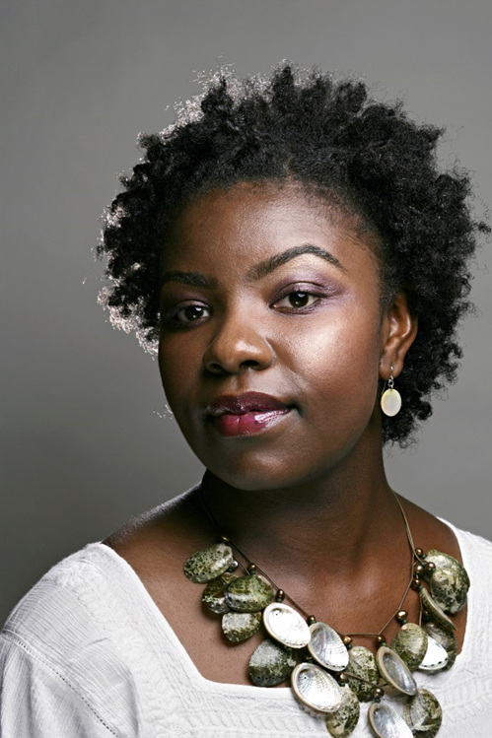
Lena impumelelo enkulu kakhulu ebingeke yenzeke ngaphandle kokuzinikela kwabambiqhaza bocwaningo lwethu.
Yathini imiphumela yocwaningo u-ASPIRE?

Slide 5
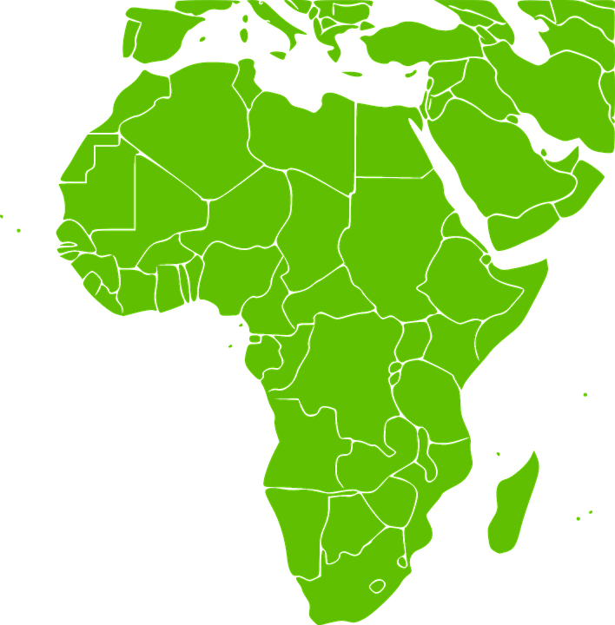
Ngabe iringi yedapivirine yesitho sowesifazane sangasese sangaphambili izotholakala nini emiphakathini yethu?
I-IPM, iqembu elasungula iringi, isebenza nohulumeni kanye nabanye ophathina ngenhloso yokwenza iringi itholakale emiphakathini yethu.
Asazi noma iringi izophasiswa yini, noma ukuthi empeleni isikhathi esingakanani ngaphambi kokuthi iringi ingase itholakale, kodwa lenqubo ivamise ukuthatha iminyaka eminingana.
Notes:
Lenqubo ibandakanya izishayamthetho eziningi kanye nokuvunywa okuqondene nezwe futhi ngakunye kuthatha isikhathi.

Slide 6
Lwenziwelani ucwaningo lwaHOPE?
U-HOPE ucwaningo oluyi Open-Label Extension (OLE), lwakhelwe ukunikeza ababambiqhaza ukufinyelela kumkhiqizo wocwaningo osebenzayo ngaphambi kokuthi itholakale emphakathini.
Notes:
Ucwaningo lwe Open-Label Extension luyaqhutshwa futhi ukuqoqa ulwazi olwengeziwe mayelana nomkhiqizo, njengokuphepha kanye nokusebenzisa umkhiqizo ngokuthembeka.

Slide 7
Inhloso esemqoka yocwaningo lwe uHOPE ukunika ababambiqhaza ukufinyelela okuphuthumayo kwiringi yesitho sowesifazane sangasese sangaphambili enedapivirine, evezwe njengephephile futhi enciphisa ubungozi bokuthola iHIV.
Lwenziwelwani ucwaningo lwaHOPE?

Slide 8
Ubani ofanelekile ukuba socwaningweni luka HOPE?
Okwamanje, abesifazane ababebambe iqhaza ocwaningweni u ASPIRE kuphela abazobhekelelwa ukungeniswa kuHOPE.
Abesifazane kumele baqonde izidingo zocwaningo, bese bevuma ukubamba iqhaza.

Slide 9
Ubani okufanele ukuba
socwaningweni uHOPE?
Abesifazane kumele babe sesimeni esihle sempilo, bangabi negciwane leHIV, futhi bangakhulelwa noma bangancelisi ibele.
Abesifazane bazoba nokuhlolwa kwezempilo kanye nokuhlola ukuqinisekisa ukuthi bafanelekile ukungena kuHOPE.

Slide 10
Lozothatha isikhathi esingakanani ucwaningo? Kuzoba emva kwesikhathi esingakanani ukuvakasha kwasocwaningweni?
Owesifazane ngamunye olungenalayo uzoba ku HOPE isikhathi esilinganiselwa kunyaka owodwa.
Ukuvakasha kwasocwaningweni kuzoba nyanga zonke kwizinyanga ezintathu zokuqala, bese kuba Kanye emva kwezinyanga ezintathu ngemuva kwalokho.
Notes:
Open-Label Extension studies are also conducted to collect additional information about the product, like about safety and adherence.

Slide 11
Ngabe amaringi esitho sangasese sabesifazane sangaphambili anjani kuHOPE?
Bonke abesifazane bazonikezwa iringi yesitho sowesifazane sangasese sangaphambili equkethe idapivirine ukuyisebenzisa ngenyanga.
Notes:
Kungafani naku ASPIRE, awekho amaringi e-placebo (angenamuthi) kuHOPE.

Slide 12
Bazocelwa ukuthi benzeni abesifazane abangenele uHOPE?
Bonke ababambiqhaza abafanelekile bazomenywa ukuthi bajoyine uHOPE bese beza ngokujwayelekile ekuvakasheni kwasocwaningeni okuhleliwe.

Slide 13
Bazocelwa ukuthi benzeni abesifazane abangenele uHOPE?
Bonke ababambiqhaza bazoba nokuzikhethela ukusebensiza/ukunikezelwa iringi yesitho sowesifazane sangasese sangaphambili enedapivirine njalo ngenyanga.
Abesifazane bangajoyina ucwaningo akukhathalekile noma bakhetha iringi njengendlela yokuvikela iHIV noma cha.

Slide 14
Bazocelwa ukuthi benzeni abesifazane abangenele uHOPE?
Abesifazane abakhetha iringi njengendlela yokuvikela iHIV bazonikezwa ukwelulekwa kanye nemiyalelo ngokusebenzisa iringi bese becelwa ukuthi baphendule imibuzo ngokusebenzisa iringi.

Slide 15
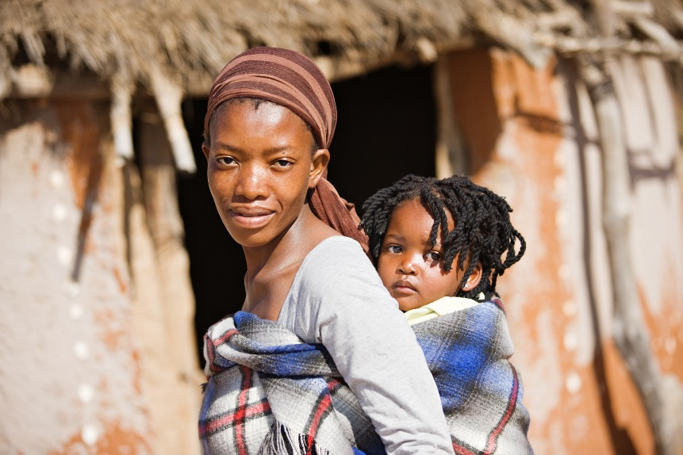
Bazocelwa ukuthi benzeni abesifazane abangenele uHOPE?
Abesifazane bangawushintsha umqondo wabo ngokusebenzisa iringi ngisho emva kokuba esejoyinile ucwaningo.
Khumbula, kodwa, ukuthi iringi ingavikela kuphela ikwi HIV uma isetshenziswa.
Notes:
Bonke ababambiqhaza benza igalelo elibalulekile obalulekile ocwaningweni inqobo nje betshela abasebenzi bocwaningo uma bengayisebenzisi iringi.

Slide 16
Bazocelwa ukuthi benzeni abesifazane abangenele uHOPE?
Bonke abambambiqhaza, kungakhathalekile ukusetshenziswa kweringi, bazocelwa ukuthi:
Baphendule imibuzo mayelana nempilo yabo nokuziphatha kwezocansi
Bathole ukwelulekwa kokunciphisa ubungozi kanye namakhondomu
Basebenzise izindlela zokuhlela umndeni ukuvimbela ukukhulelwa

Slide 17
Bazocelwa ukuthi benzeni abesifazane abangenele uHOPE?
Bonke abambambiqhaza, kungakhathalekile ukusetshenziswa kweringi, bazocelwa ukuthi:
Kokunye ukuvakasha, babe nokuhlolwa kwezempilo
Bazoba nokuhlolwa kwaselebhu, kubandakanya ukuhlolelwa amaSTI, ukukhulelwa, kanye neHIV
Bazonikeza amasampula egazi, izinwele, kanye namaswabhu esitho sangasese sowesifazane sangaphambili

Slide 18
Kwenzekani ngabesifazane abanqaba ukungeniswa kuHOPE?
Uma umbambiqhaza enquma ukungangeneli uHOPE, uzobuzwa ukuthi uzimisele yini ukuba nokuvakasha okukodwa ukunikeza ulwazi ngokuthi kungani enqaba ukungeniswa.

Slide 19
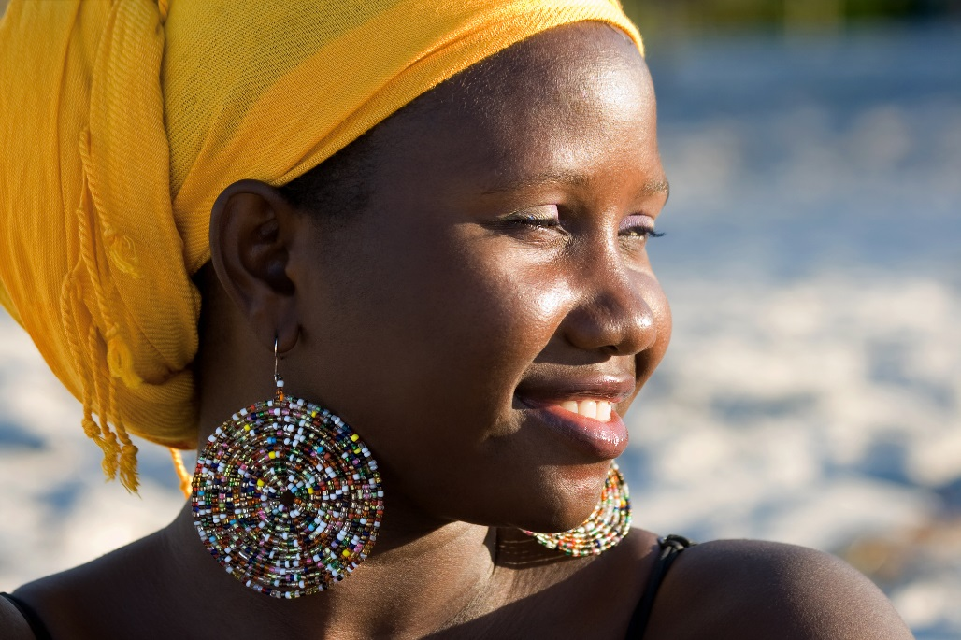
Kwenzekani ngabesifazane abanqaba ukungeniswa kuHOPE?
Ababambiqhaza abanqaba ukungeniswa bangawushintsha umqondo wabo bese bengenela kuHOPE, kuncike ekutheni ucwaningo lusaqhubeka futhi besahlangabezana nezidingo zokufaneleka.

Slide 20
Ibuphi ubungozi?
Ubungozi bokubamba iqhaza ku HOPE kunokufana naku-ASPIRE:
Ungezwa unokungakhululeki noma ubuhlungu uma uhlolwa noma ukhishwa igazi.
Iringi yesitho sangasese sowesifazane sangaphambili ingazwakala ingabakhululi abanye besifazane, futhi abanye bangaba nokulunywa, uketshezi oluphumayo, noma ezinye izimpawu.

Slide 21
Ibuphi ubungozi?
Ungahlazeka ngemibuzo nezinqubo ocwaningweni.
Kungenzeka ukuthi wena noma uphathina wakho angayizwa iringi ngesikhathi kwenziwa ucansi.

Slide 22
Ibuphi ubungozi?
Kwisigameko esingavamisile kwenzeka usuleleka ngesandulela ngculaza,ungaba nokungasebenzi kwemishanguzo ngenxa yokujwayela uma uqhubeka nokusebenzisa iringi.
Kungenzeka ukuthi abanye bangakuphathi ngendlela noma bakubandlulule ngokubamba iqhaza ocwaningweni.

Slide 23
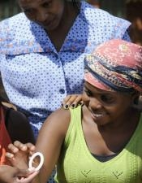
Iziphi izinzuzo?
Ngesikhathi ubambe iqhaza ocwaningweni, abesifazane kuHOPE bazonikwa ukufinyelela kwiringi yesitho sangasese sowesifazane sangaphambili etholakale ukuthi iphephile futhi isebenza ngempumelelo ekuvimbeni iHIV.

Slide 24
Iziphi izinzuzo?
Abesifazane ocwaningweni bazothola futhi ukuhlolwa kwezempilo, ukuhlola okubheka impilo yabo, ukuhlela umndeni, ukwelulekwa ngeHIV/STI kanye nokuhlola, kanye nokwelashwa noma ukwedluliselwa, uma kudingeka.

Slide 25
Bangenzani ophathina namalungu omphakathi?
Abesifazane abafanelekile, banquma ukuthi bayajoyina yini uHOPE Kanye nokuthi bayayisebenzisa yini iringi kuwunguzikhethela komuntu ngamunye. Abesifazane bayagqugquzelwa ukuxoxa ngezinqumo zabo nophathina babo kanye nabanye abantu ababalulekile kubona.
Notes:
Abasebenzi bocwaningo bazogcina ulwazi ngabesifazane ocwaningweni luyimfihlo, kodwa bakhona ukuxoxa ngoHOPE bese bephendula noma imiphi imibuzo ophathina noma amalungu omphakathi abanayo, uma kudingeka. Ngokubaseka, ophathina kanye namalunga omphakathi ayasiza nawo ukulwisana neHIV/AIDS.

Slide 26
Uma unemibuzo noma udinga ulwazi olwengeziwe, sicela uvakashele eklinikhi yocwaningo.

